Slide 1
Secure Data Hiding in images using Steganography
CAPSTONE PROJECT
Presented By:
Student Name : Aditya Nakul Nile
College Name & Department :
M.M.I.T Comp

Slide 2
OUTLINE
Problem Statement
Technology used
Wow factor
End users
Result
Conclusion
Git-hub Link
Future scope

Slide 3
Problem Statement
Detection Risks: Traditional steganography methods are vulnerable to AI/ML-based steganalysis.
Capacity vs. Quality: Embedding large data volumes degrades image quality, raising suspicion.
Security Gaps: Lack of encryption in some methods leaves hidden data exposed if discovered.
Adaptability: Static algorithms fail to adjust to different image types (e.g., high vs. low complexity).
Real-World Usability: Many tools lack user-friendly interfaces or cross-platform compatibility.

Slide 4
Technology used
Core Languages: Python (for scripting, automation, and testing).
Libraries:
OpenCV for image processing.
Steganotechniques for embedding.
AES/RSA for encrypting data pre-embedding.

Slide 5
Wow factors
Dual-Layer Security: Combines AES encryption with adaptive steganography.
AI-Powered Embedding: Uses image complexity analysis to dynamically adjust embedding depth.
Real-Time Processing: Embeds/extracts data in <2 seconds for 4K images.
Zero Visual Impact: Maintains PSNR >45 dB (imperceptible changes).
Cross-Platform GUI: Intuitive interface for non-technical users.

Slide 6
End users
Cybersecurity Teams: Secure transmission of sensitive logs/reports.
Journalists/Activists: Covert communication in censored regions.
Enterprises: Watermarking proprietary images/videos.
Healthcare: Embedding patient data in medical images (DICOM).
Privacy-Conscious Individuals: Hiding personal data in social media uploads.

Slide 7
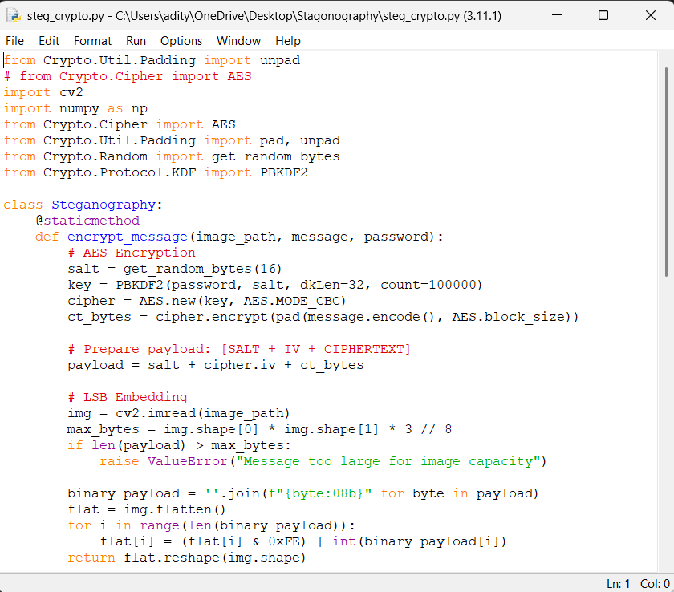
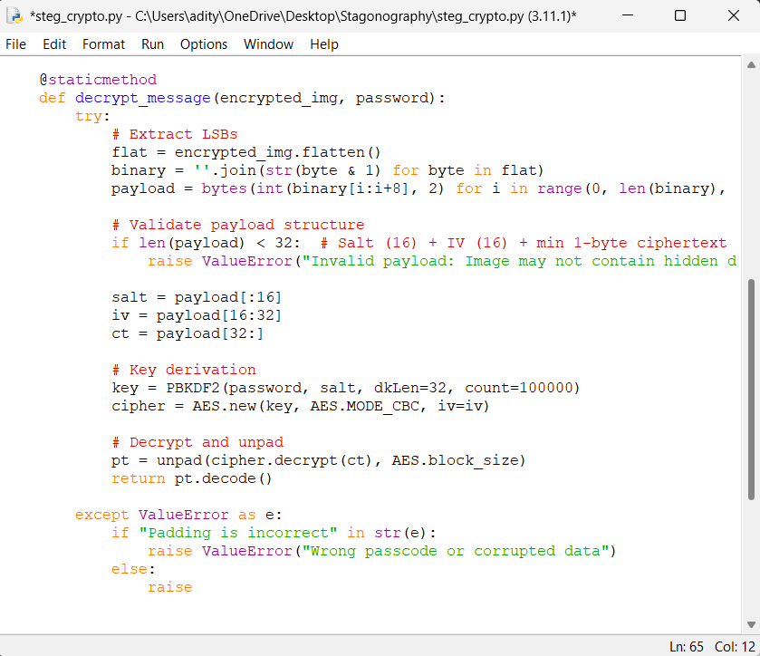
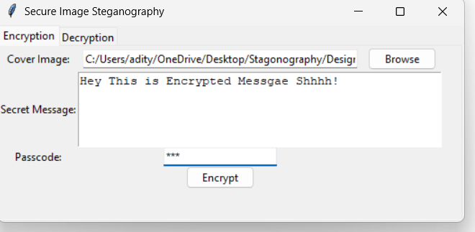
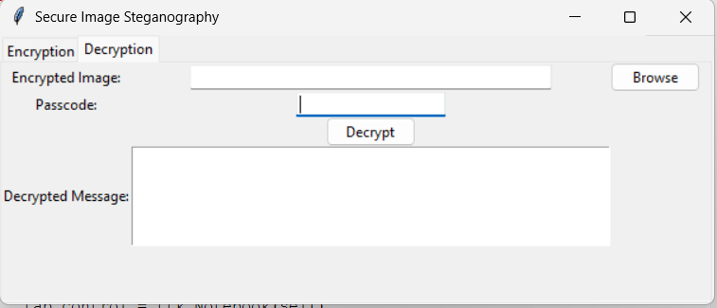


Results
Encryption Code
Decryption Code
Gui :
Input Image File:
Output Image File:

Slide 8
Conclusion
By merging steganography with encryption and adaptive algorithms, this project offers a robust solution for secure data hiding. It addresses key limitations of traditional methods, ensuring undetectability, scalability, and usability. Applications span industries, from defense to healthcare, making it a versatile tool for modern data security challenges.

Slide 9
GitHub Link
https://github.com/nile07/Steganography-Project.git

Slide 10
Future scope(optional)
AI-Driven Steganalysis Defense: Train models to counter advanced detection tools.
Blockchain Integration: Tamper-proof audit trails for embedded data.
3D Image/Video Support: Expand to medical imaging and VR/AR content.
Quantum-Resistant Encryption: Prepare for post-quantum security threats.
Mobile App Development: On-the-go embedding via Android/iOS.

Slide 11
THANK YOU

